Slide 1
Introduction to Computer Programming Lecture 3.1:
Loops
Hemma Philamore
Department of Engineering Mathematics

Slide 2
Introduction to Computer Programming Lecture 3.1.a:
For Loops
Hemma Philamore
Department of Engineering Mathematics

Slide 3


Loops
Do this!
4
Do this!
Do this!
Do this!
Do this!
Do this!
x<8
# iterations
condition
For Loop
While Loop

Slide 4
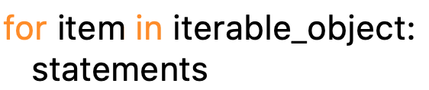
For Loop
Keyword ‘in’
Target: changes every iteration, a variable name
List
Keyword ‘for’
Colon
Indentation
Block of code carried out every iteration!
Use target value in a sensible way

Slide 5
For Loop
Notes:
Cut part in video about printing range in spyder

Slide 6
For Loop
e.g. [1,4,5,7]
e.g. print (2*item)
#
current value of Item
printing out
1
item = 1
2
2
item = 4
8
3
item = 5
10
4
item = 7
14

Slide 7
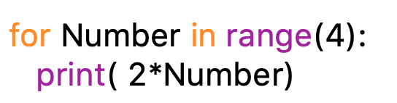
For Loop
Keyword ‘in’
Range gives you a list
of values from 0 to N-1
range(4) → 0,1,2,3
Target: changes every iteration, a variable name
Keyword ‘for’
Colon
Indentation
Block of code carried out every iteration!
Use target value in a sensible way

Slide 8
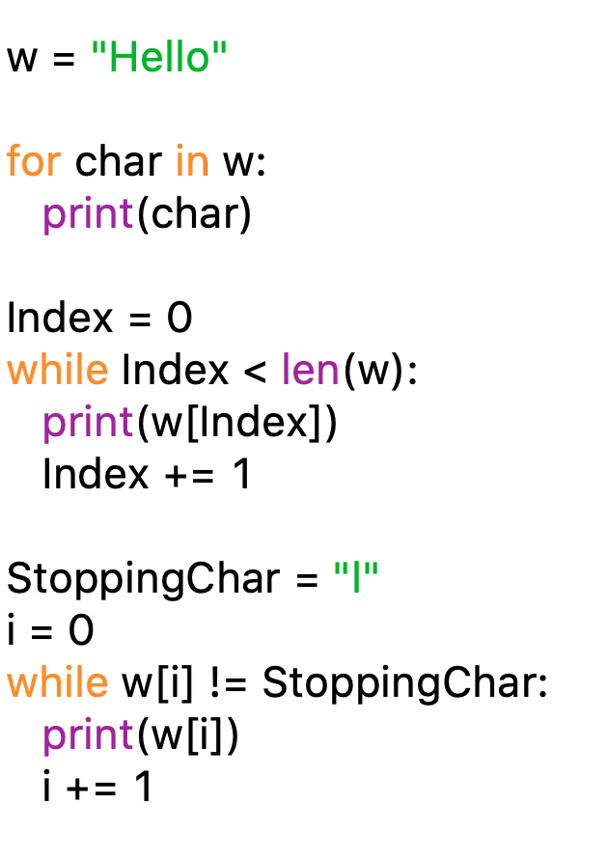
For Loop

Slide 9
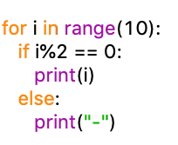
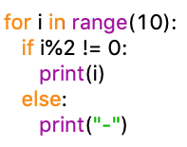
Loops and Control Flow Printing even/odd numbers
List of numbers
from 0 to 9
additional
indentation,
part of if and
for loop
even numbers
odd numbers
!= “NOT EQUAL”

Slide 10
Introduction to Computer Programming Lecture 3.1.b:
While Loops, Break & Continue
Hemma Philamore
Department of Engineering Mathematics

Slide 11
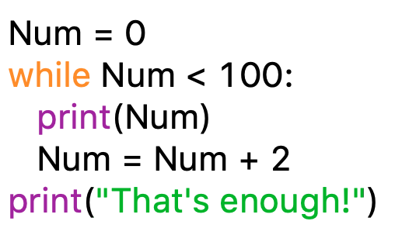
While Loop
Condition when to stop
Keyword ‘while’
Needs to include changes such that condition eventually can be met

Slide 12
While Loop

Slide 13
While Loop
Same loop implemented
with while
Until first
“l” is found

Slide 14
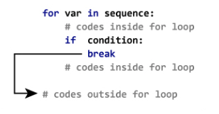
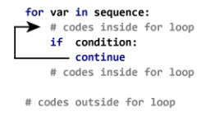
Break & Continue
Break
Sometimes we want to exit a for or while loop prematurely i.e skip all remaining values
Continue
Sometimes, instead of skipping all remaining values, we want to skip just one value in a loop.

Slide 15
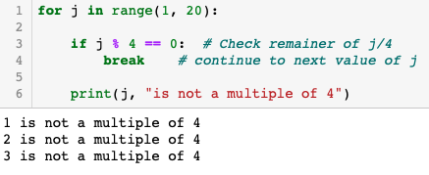
Break

Slide 16
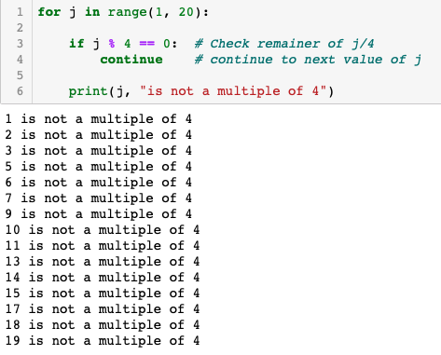
Continue

Slide 17
Summary
Loops allow you to execute the same code over and over and over again.
There are two ways to do a loop: for and while.
Use break or continue to exit a loop, (or good stopping conditions).
Note: Check help (range) for a useful way to make lists of integers.

